Slide 1
GCSE Radiation
W Richards
Worthing High School

Slide 2
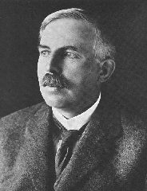
Structure of the atom
A hundred years ago people thought that the atom looked like a “plum pudding” – a sphere of positive charge with negatively charged electrons spread through it…
Ernest Rutherford, British scientist:
I did an experiment that proved this idea was wrong. I called it the “Rutherford Scattering Experiment”

Slide 3
The Rutherford Scattering Experiment
Alpha particles (positive charge)
Thin gold foil
Some particles passed through, some were deflected backwards
Conclusion – atom is made up of a small central nucleus surrounded by electrons orbiting in shells

Slide 4
The structure of the atom
ELECTRON – negative, mass nearly nothing
PROTON – positive, same mass as neutron (“1”)
NEUTRON – neutral, same mass as proton (“1”)

Slide 5
The structure of the atom
Particle | Relative Mass | Relative Charge
Proton | 1 | 1
Neutron | 1 | 0
Electron | 0 | -1
MASS NUMBER = number of protons + number of neutrons
4
He
SYMBOL
2
PROTON NUMBER = number of protons (obviously)

Slide 6
Background Radiation
13% are man-made
Radon gas
Food
Cosmic rays
Gamma rays
Medical
Nuclear power

Slide 7
Radioactivity
If a substance is capable of ALWAYS emitting radiation under any conditions we say it is ____________. There are three types of radiation: ALPHA, _____ and GAMMA. These types of radiation are always given off by rocks, _____, building materials, air and cosmic rays around us – this is called BACKGROUND RADIATION. Each type is capable of penetrating different materials:
α
β
γ
Sheet of paper
Few mm of _________
Few cm of lead
Words – aluminium, beta, food, radioactive

Slide 8
Isotopes
An isotope is an atom with a different number of neutrons:
Notice that the mass number is different. How many neutrons does each isotope have?
16
17
18
O
O
O
8
8
8
Each isotope has 8 protons – if it didn’t then it just wouldn’t be oxygen any more.
A “radioisotope” is simply an isotope that is radioactive – e.g. carbon 14, which is used in carbon dating.

Slide 9
Types of radiation
1) Alpha (α) – an atom decays into a new atom and emits an alpha particle (2 protons and 2 neutrons – the nucleus of a helium atom)
Unstable nucleus
New nucleus
Alpha particle
2) Beta (β) – an atom decays into a new atom by changing a neutron into a proton and electron. The fast moving, high energy electron is called a beta particle.
Beta particle
Unstable nucleus
New nucleus
3) Gamma – after α or β decay surplus energy is sometimes emitted. This is called gamma radiation and has a very high frequency with short wavelength. The atom is not changed.
Unstable nucleus
New nucleus
Gamma radiation

Slide 10
Ionisation
When radiation collides with neutral atoms or molecules it alters their structure by knocking off electrons. This will leave behind IONS – this is called IONISING RADIATION.
α particle
Electron

Slide 11



Uses of radioactivity
1) Medical uses – gamma rays can be used to destroy cancerous cells or to sterilise medical instruments
2) Tracers – a tracer is a small amount of radioactive material used to detect things, e.g. a leak in a pipe:
Gamma source
The radiation from the radioactive source is picked up above the ground, enabling the leak in the pipe to be detected.
Tracers can also be used to develop better plant fertilisers and in medicine to detect tumours:

Slide 12
Uses of radioactivity 2
Beta detector
Rollers
Paper
Beta emitter

Slide 13
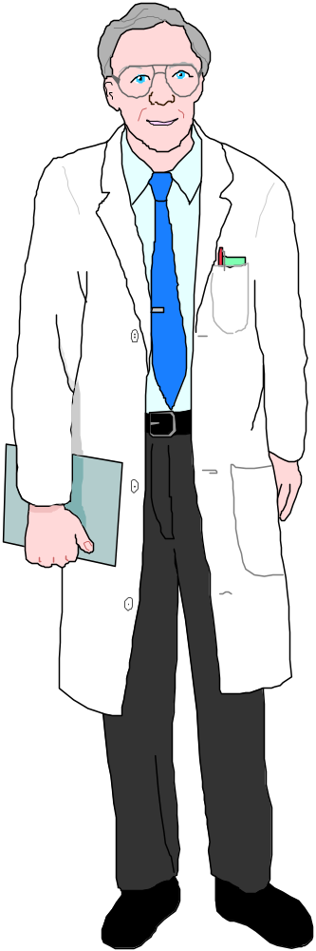
Dangers of radioactivity
Radiation will ionise atoms in living cells – this can damage them and cause cancer or leukaemia.
Alpha
Beta
Gamma
OUTSIDE the body β and γ are more dangerous as α radiation is blocked by the skin.
INSIDE the body an α source causes the most damage because it is the most ionising.

Slide 14
Half life
The decay of radioisotopes can be used to measure the material’s age. The HALF-LIFE of an atom is the time taken for HALF of the radioisotopes in a sample to decay…
= radioisotope
= new atom formed
After 1 half life half have decayed (that’s 8)
After 2 half lives another half have decayed (12 altogether)
After 3 half lives another 2 have decayed (14 altogether)
At start there are 16 radioisotopes

Slide 15
A radioactive decay graph
Count
Time
1 half life

Slide 16
Dating materials using half-lives
Question: Uranium decays into lead. The half life of uranium is 4,000,000,000 years. A sample of radioactive rock contains 7 times as much lead as it does uranium. Calculate the age of the sample.
Answer: The sample was originally completely uranium…
1 half life later…
1 half life later…
1 half life later…
8
4
2
1
8
8
8
8
…of the sample was uranium
Now only 4/8 of the uranium remains – the other 4/8 is lead
Now only 2/8 of uranium remains – the other 6/8 is lead
Now only 1/8 of uranium remains – the other 7/8 is lead
So it must have taken 3 half lives for the sample to decay until only 1/8 remained (which means that there is 7 times as much lead). Each half life is 4,000,000,000 years so the sample is 12,000,000,000 years old.

Slide 17
An exam question…
(AQA 2001 Higher Paper)
Potassium decays into argon. The half life of potassium is 1.3 billion years. A sample of rock from Mars is found to contain three argon atoms for every atom of potassium. How old is the rock?
(3 marks)
The rock must be 2 half lives old – 2.6 billion years

Slide 18
Nuclear fission
More neutrons
Neutron
Unstable nucleus
Uranium nucleus
New nuclei (e.g. barium and krypton)

Slide 19
Chain reactions
Each fission reaction releases neutrons that are used in further reactions.

Slide 20
Fission reactions summary
Each fission reaction releases energy in the form of _______. In a nuclear power plant this heat is used to boil _______, which is used to drive turbines etc. The energy from each reaction is very ______, but there are ________ of reactions every second. The waste products from these reactions are __________, which is why nuclear power plants are ___________.
Words – radioactive, water, billions, controversial, heat, small

